Slide 1
Life Bay View Private Hospital

Slide 2
Overview
History
  Opened in 1995
  Sustained growth from commissioning
  Only Cardiac Centre in the Southern Cape
  Full complement of major specialities
  24 Hour Accident & Emergency Unit

Slide 3
Awards
Discovery Top 20 Hospital
  2015
  2016
PMR Diamond Arrow
  2016
Mossel Bay Business Chamber – Business of the Year
  2015
  2017

Slide 4
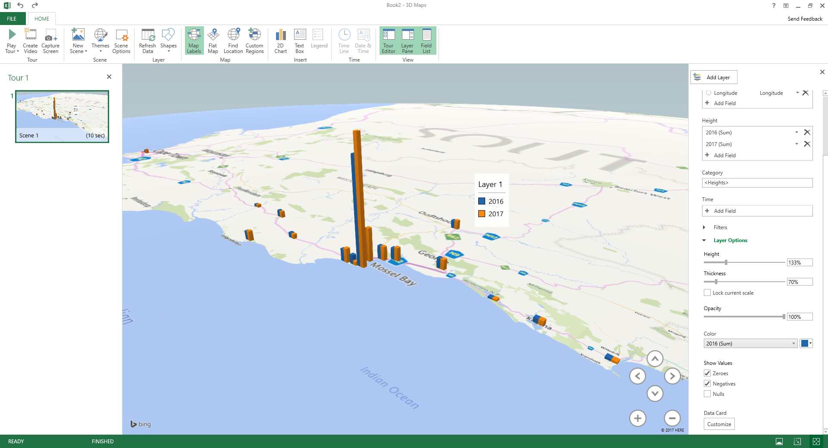
Catchment area

Slide 5
Supporting Private Facilities
Competitor name | No of beds Active (undeveloped) | Distance from the hospital | Other
Vidamed | 35 | 300m | Day clinic and step-down
George Mediclinic | 160 | 50km | Acute beds
Geneva Mediclinic | 58 | 50km | Acute/day beds
Klein Karoo Mediclinic | 43 | 90km | Acute/day beds
Kango Oudtshoorn | 14 | 90km | Day beds
Stilbaai Private hospital | 38 | 100km | Not commissioned

Slide 6
Doctor Additions
Dr S Hurter – Phycisian
Dr H van Heerden – Neuro-surgeon
Dr G Wessels – Ear, Nose & Throat
Dr C Verster – Plastic Surgeon (Mossel Bay & George)
Dr N Bernard – Anesthetist

Slide 7

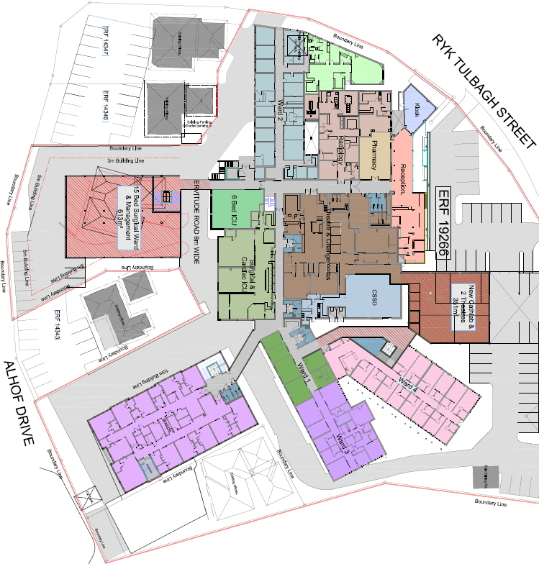
3 – 5 year growth strategy
Infrastructure
Additional Surgical ward beds
Additional Medical ward beds
Additional ICU Beds
New Cathlab & Theatres
Parking deck
Consulting Rooms
College of Learning
Supporting services
  Surgical stores
  Laundry

